Slide 1
Transformers

Slide 2
Objectives
Input Representation
Tokenization (text, images, audio)
Embeddings
Attention
queries, keys and values
Attention pooling and interpretability
Scoring functions
Distance-based
Scaled Dot-Product
Additive scores
Machine Translation
Word-level tokenization
Evaluation: BLEU score
Encoder–Decoder solution
Encoder
Decoder
Limitation

Slide 3
Introduction
Deep learning architectures (MLP, CNN, RNN) are scaled-up and refined versions of classical ideas
Progress is largely due to more compute (GPUs) and larger datasets
The Transformer abandons recurrence and convolution in favour of self-attention
It captures long-range dependencies and complex, context-dependent interactions in a flexible and scalable way
Provides a unified framework: the same architecture works for text, images, audio and multimodal data

Slide 4
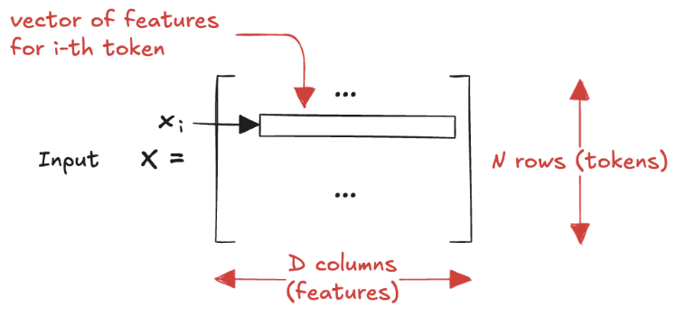
Input Representation
A Transformer does not operate on raw inputs (characters, pixels, samples)
Its input is a sequence of N tokens, each represented by a vector of size D
Stacking row-wise gives the input matrix X with shape (N, D)
Unlike MLPs, each row is a token within a single example, columns are coordinates in a learned representation space
All modality-specific structure must be handled before this stage: tokenization

Slide 5

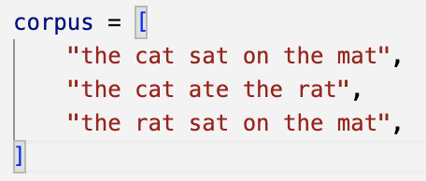
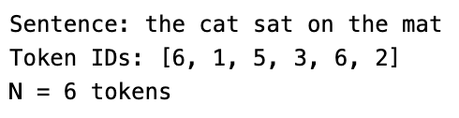
Tokenization: text
In text, the natural choice is to split a sentence into words
Each word is mapped to an integer index drawn from a fixed vocabulary
From this point onward the model sees only sequences of discrete identifiers (tokens)
Better in practice: subword tokenization, decomposes words into smaller fragments

Slide 6
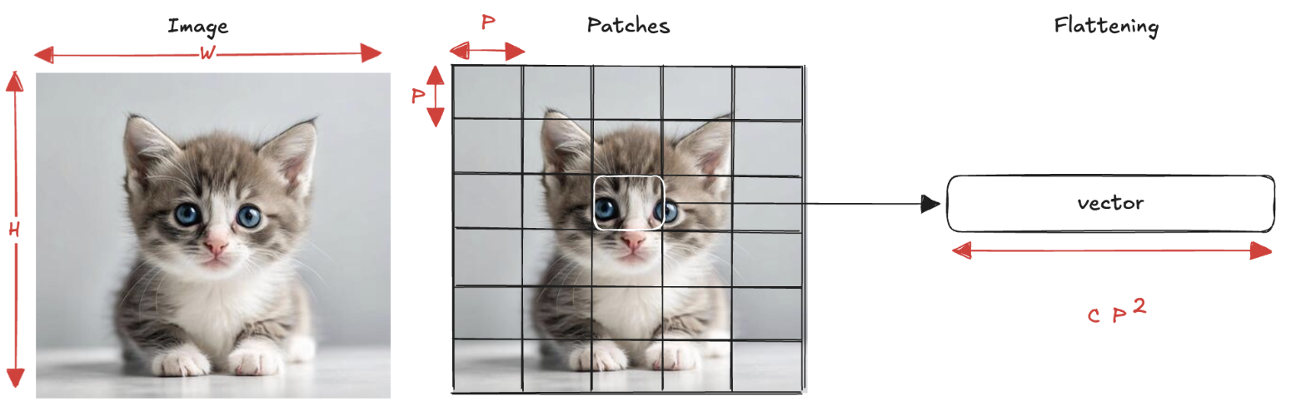

Tokenization: Images
An image is tokenized by dividing it into non-overlapping patches of size P×P
Each patch contains C channels (e.g. 3 for RGB).
Flattening yields a vector of length C×P×P per patch
Output shape: (B, N, C×P×P) where B is the batch size and N = (H/P)×(W/P)
Example: P=16

Slide 7
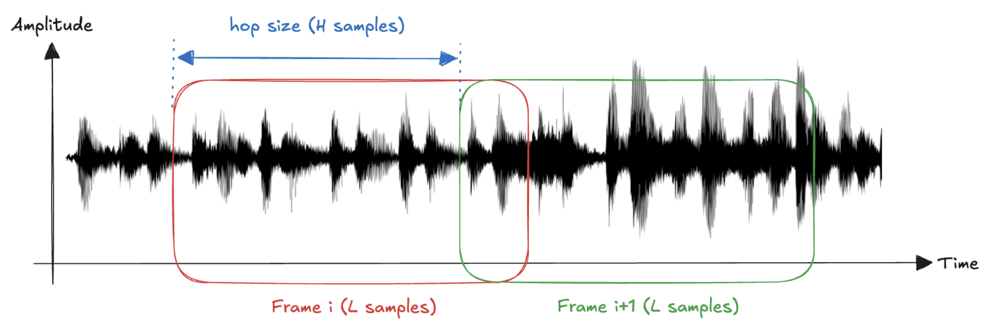
Tokenization: Audio
An audio waveform is long and continuous; there is no natural notion of token boundaries
Tokenization requires imposing a segmentation in time
Simplest approach: framing, partition the signal into segments of length L, sliding by hop H
If H=L the frames do not overlap; if H<L frames share part of the signal
Alternative: tokenize a time–frequency representation (spectrogram), then treat it like an image

Slide 8

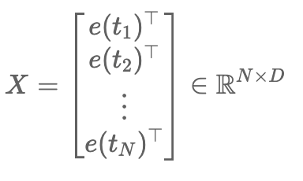
Embeddings
Tokenization provides a collection of discrete symbolic units, but these units are not yet suitable for numerical computation.
The role of embeddings is to map each token into a vector in a shared D-dimensional space
Applying this mapping to the tokens produced during tokenization yields the input representation matrix:
Key point: embeddings do not merely encode tokens, they define the geometry in which it is possible to measure compatibility
two tokens with similar embeddings, can easily considered similar

Slide 9
Attention (1)
Every architecture we have discussed relied (explicitly or implicitly) on the assumption that the input lives in a fixed, well-defined shape.
In ImageNet classification, we resize or crop images to 224x224 pixels
In time-series forecasting, an RNN is fed windows of a predetermined length, so "how much past" the model sees is fixed in advance
This design choice is convenient, but it becomes a bottleneck when the input is genuinely variable in size and in information content.
When sequences get long, the difficulty is not merely computational, it is conceptual
the model must decide what to retain
what to forget
how to access something it saw many steps ago
Keeping track of "everything so far" becomes increasingly fragile as the context grows

Slide 10

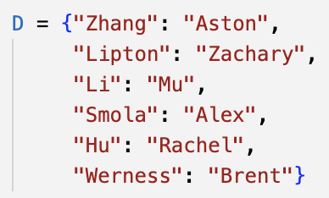
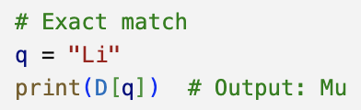
Attention (2)
What we need is a mechanism that can selectively read from a large collection of information
the amount of stored data can grow arbitrarily
the way we access it remains stable and efficient
A natural place to look is the abstraction of a database
a collection of items
each addressed by a key
and carrying a value
We operate on the database by issuing a query
Exact query to retrieve a specific entry
Approximate query to retrieve all entries whose key start with a given prefix
Example:
We can imagine more complex queries
Crucial point: database size can vary (we can add or remove entries), however the query mechanism is stable (we do not need to change the way we query it)

Slide 11
Attention (3)
We can formulate a query as an operation on key–value pairs in a way that does not depend on the database size
The same mathematical object makes sense whether the database contains a handful of items or millions
The same query can produce different outputs
The answer is not "hard-coded" in the procedure
It is induced by the current contents of the database
Operating over an enormous state space does not require complicated code
The mechanism can be as elementary as exact lookup or approximate matching
The complexity is pushed into the representation and the similarity score function
None of this requires compressing or simplifying the database
we can keep a large collection of stored information and still read from it effectively by learning how to address it
This perspective leads directly to one of the most influential architectural ideas of the last decade: the attention mechanism

Slide 12
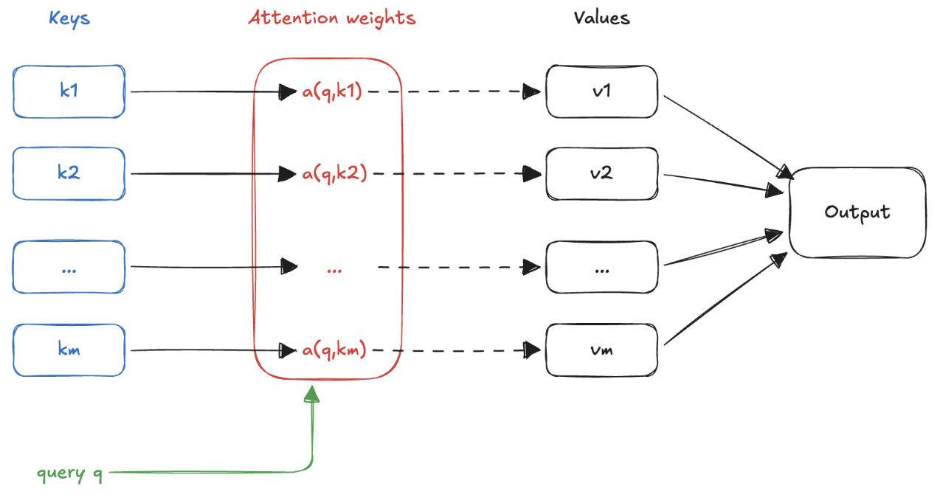
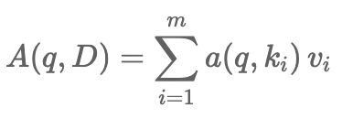

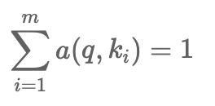
Attention pooling
The term attention is natural: we assign large weights only to a subset of entries, and the output is dominated by the corresponding values, those are the items the model is effectively "paying attention" to
Nonnegativity constraint:
Sum-to-one constraint:

Slide 13
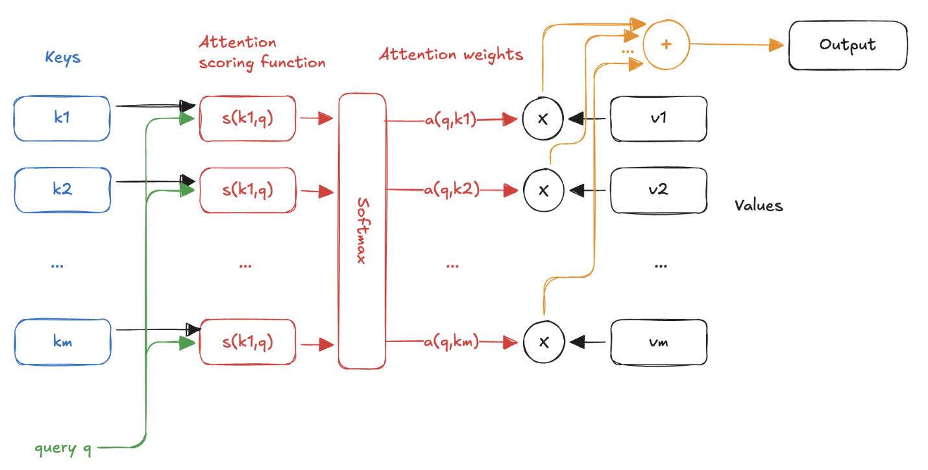
Scoring functions
An attention layer is essentially determined once we specify how to measure the compatibility between a query and a key

Slide 14

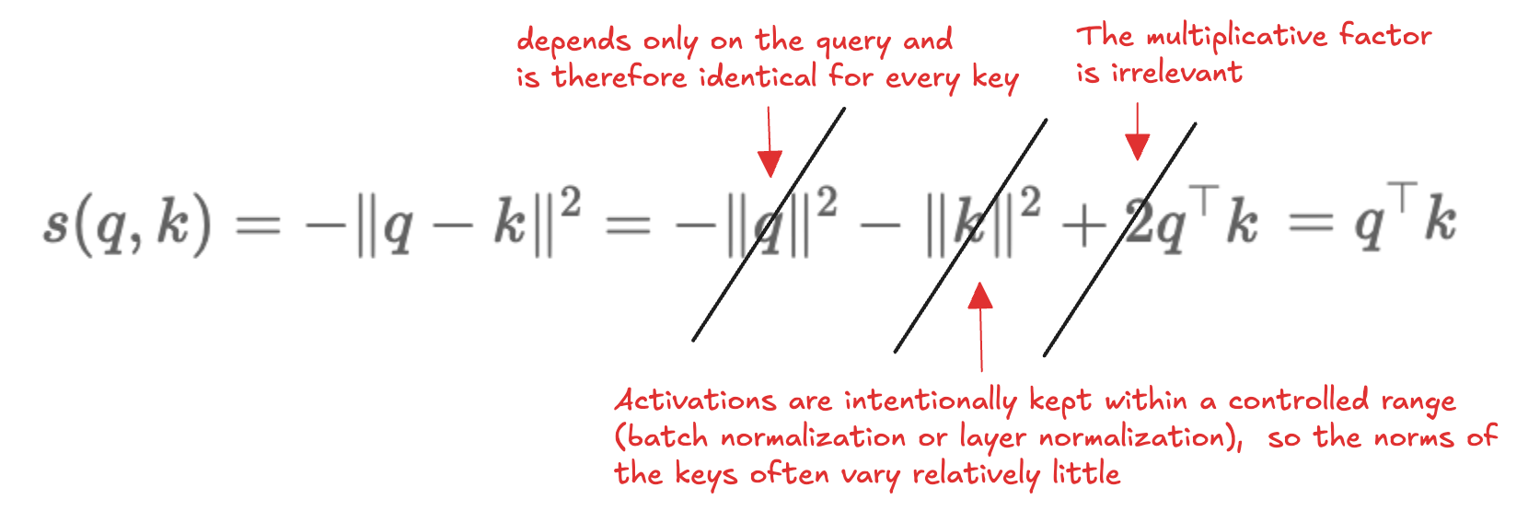
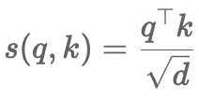
Distance-based scoring (1)
A conceptually simple way to build such a score is to start from distance
This directly encodes the intuitive principle that closer means more relevant: keys located near the query in representation space receive larger scores and therefore larger attention weights
Computing distances is not hardware-friendly:
The dot product has variance proportional to the dimensionality, so we use scaled dot-product score:

Slide 15


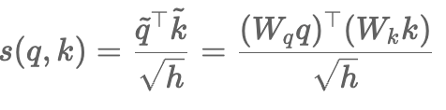
Generalized Distance-based scoring
We have assumed that queries and keys belong to the same vector space, meaning that they share the same dimensionality
While convenient, this assumption is not fundamental to the attention mechanism itself
In many practical settings, queries and keys naturally arise from different representations and may therefore have incompatible dimensions
A solution is to learn two linear projections that map queries and keys into a common latent space of dimension h

Slide 16

Learnable scoring
Scaled dot-product score is efficient and well-motivated, but it encodes a specific assumption about what "compatibility" means:
Two vectors are similar when they point in the same direction
However, the relevant relationship is not necessarily geometric alignment
The scoring function itself can be a learnable component, one that can discover from data what "relevant" means for the task at hand
This is the idea behind the additive score:
Rather than combining the projected query and key by multiplication
We sum them and then pass through a nonlinearity, letting a small learned function shape their interaction
This gives the mechanism greater expressive flexibility, since the notion of "match" is no longer restricted to correlations captured by an inner product

Slide 17
Machine Translation
This abstract framework becomes particularly compelling when applied to problems that genuinely require a flexible, size-independent mechanism for retrieving and aggregating information
Machine translation is a canonical example of such a problem:
Transform a sentence in a source language into a sentence in a target language
Both the input and the output are variable-length sequences
There is no fixed positional correspondence between their elements
An early word in the source may influence a word generated much later in the target
Different languages may reorder grammatical structures in radically different ways
Machine translation exemplifies a large class of problems involving mappings between two unaligned sequences
The challenge:
to process sequential data
dynamically determine which parts of a sequence are most relevant to each element of the other
Attention allow a model to perform content-based retrieval over the entire input sequence while generating each output element

Slide 18
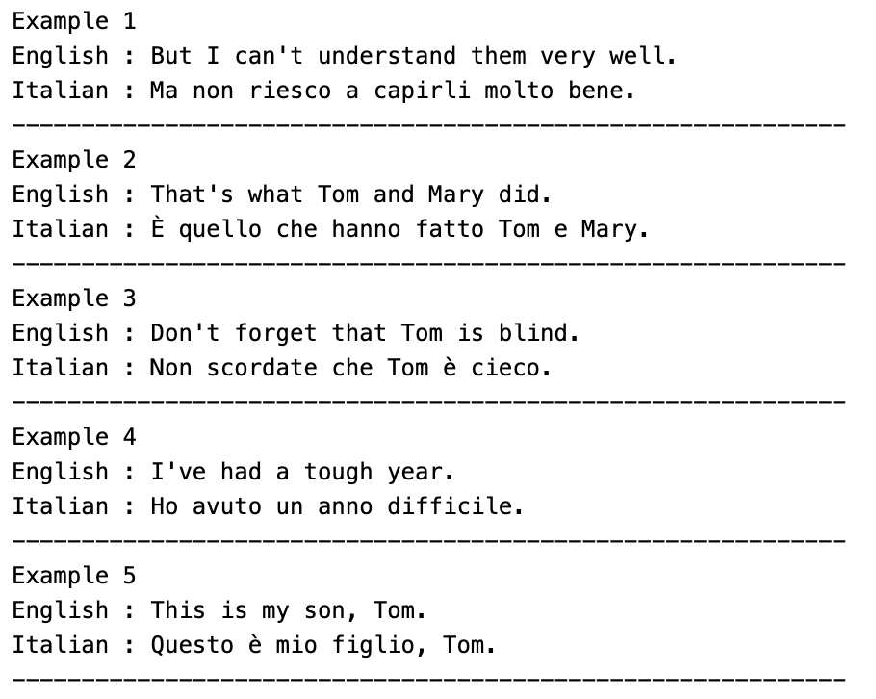
English–Italian dataset
The Tatoeba Project: a crowd-sourced collection of bilingual sentence pairs
Preprocessing steps:
non-breaking spaces are replaced with standard spaces
uppercase characters are converted to lowercase
punctuation marks are separated from adjacent words by inserting whitespace

Slide 19
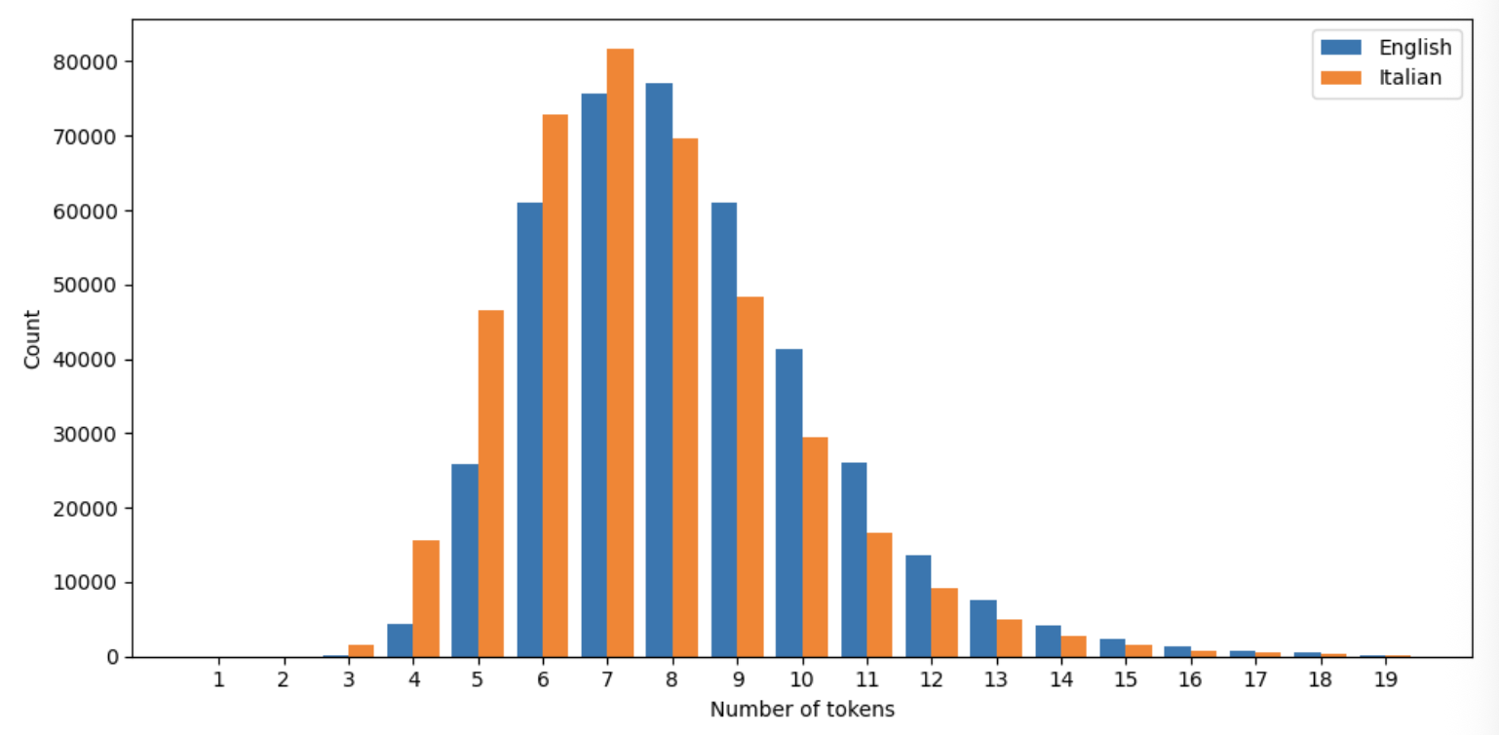
World-level Tokenization
We adopt a word-level tokenization strategy
Each token corresponds either to a word or to an individual punctuation symbol
Each sentence is decomposed into a sequence of tokens
An end-of-sequence token (<eos>) is appended to the end of the sequence
The procedure produces two collections of tokenized sequences

Slide 20
Vocabulary
We construct two distinct vocabularies
One for the source language
One for the target language
Under a word-level tokenization scheme, the number of unique tokens can grow rapidly
Each word form is treated as a separate vocabulary entry
To keep the vocabulary size manageable, tokens appearing fewer than two times in the corpus are replaced by a shared unknown token (<unk>)
The vocabularies include several special-purpose tokens used to structure and control the sequence-processing pipeline:
beginning-of-sequence token (<bos>), which marks the start of a target sentence.
end-of-sequence token (<eos>), already considered
padding token (<pad>), to standardize sequence lengths within a minibatch
The presence of these special tokens allows the model to manage variable-length sequences effectively, providing clear markers

Slide 21

Word embeddings
Token indices are merely arbitrary integer identifiers and carry no intrinsic geometric or semantic structure
Token 42 is not meaningfully "closer" to token 41 than to token 9000.
The embedding layer addresses this problem by associating each token with a learnable dense vector representation
The embedding vectors are typically initialized randomly and optimized jointly with the rest of the network during training. Over time, the model learns a geometry in which tokens appearing in similar linguistic contexts acquire similar vector representations

Slide 22
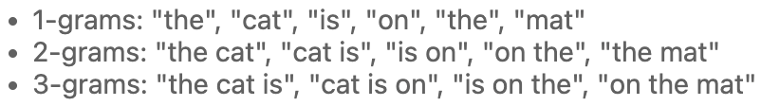

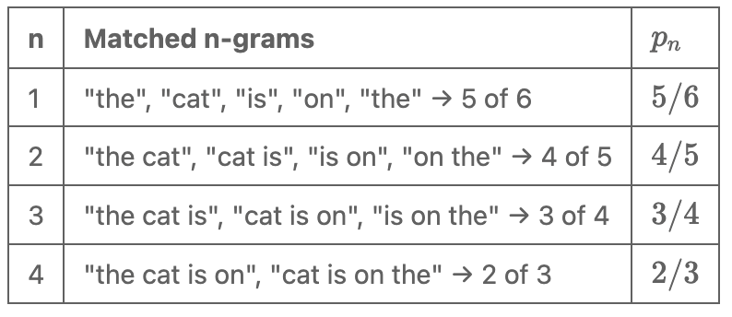
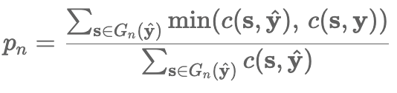
Evaluation (1)
Defining the problem also means deciding how to measure success.
A sentence can have many valid translations
Comparing two strings character by character would penalise perfectly correct outputs that simply chose different words.
The standard metric is Bilingual Evaluation Understudy (BLEU)
measures how much of the predicted output appears in the reference translation, at multiple levels of granularity
n-gram: a contiguous subsequence of exactly n tokens
Longer n-grams capture more context and impose stricter ordering constraints
Precision: to measure, for each order n, how many n-grams in the predicted sequence also appear in the reference:

Slide 23
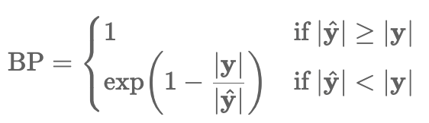
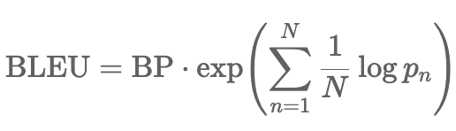
Evaluation (2)
The scores drop as n grows because a mismatch contaminates progressively longer windows
Precision alone has a blind spot
It rewards every correct word but never asks what was missed
A prediction of "the" scores a perfect unigram precision against almost any reference
The natural fix would be recall, but it is awkward when multiple valid translations of different lengths exist
BLEU instead applies a brevity penalty that discounts scores when the prediction is suspiciously short:
Combining brevity penalty with precisions gives the final BLEU score:
Precisions are combined as a geometric mean rather than an arithmetic mean, a single near-zero precision drags the whole product toward zero

Slide 24
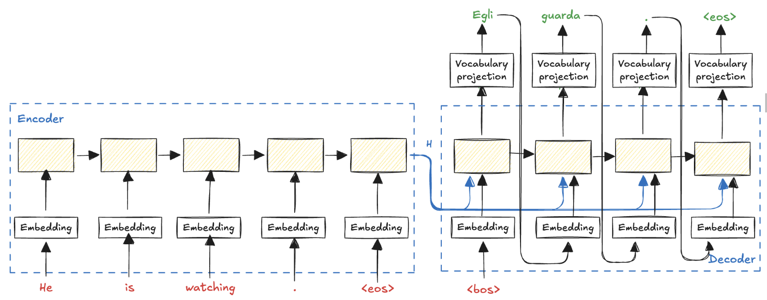
Encoder–Decoder solution (1)
The encoder–decoder architecture can be applied:
The encoder compresses the input sequence into an internal representation
The decoder generates the output sequence using that representation

Slide 25
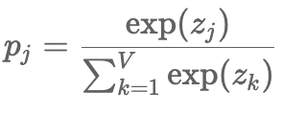

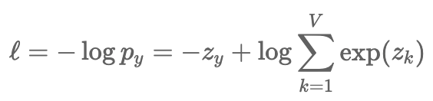
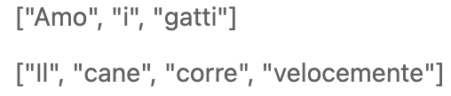

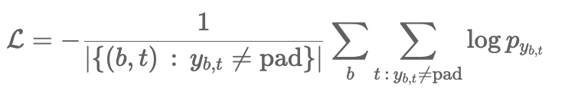
Encoder–Decoder solution (2)
At each decoding step, the model outputs a vector of logits over the target vocabulary, from which a probability distribution is obtained via softmax:
Predicting the correct next token out of several candidates Is a multi-class classification problem, making cross-entropy loss the natural objective:
Practical complication: sentences in the same minibatch generally have different lengths, so we apply padding:
Padding positions carry no meaningful prediction target, so they must be excluded:

Slide 26
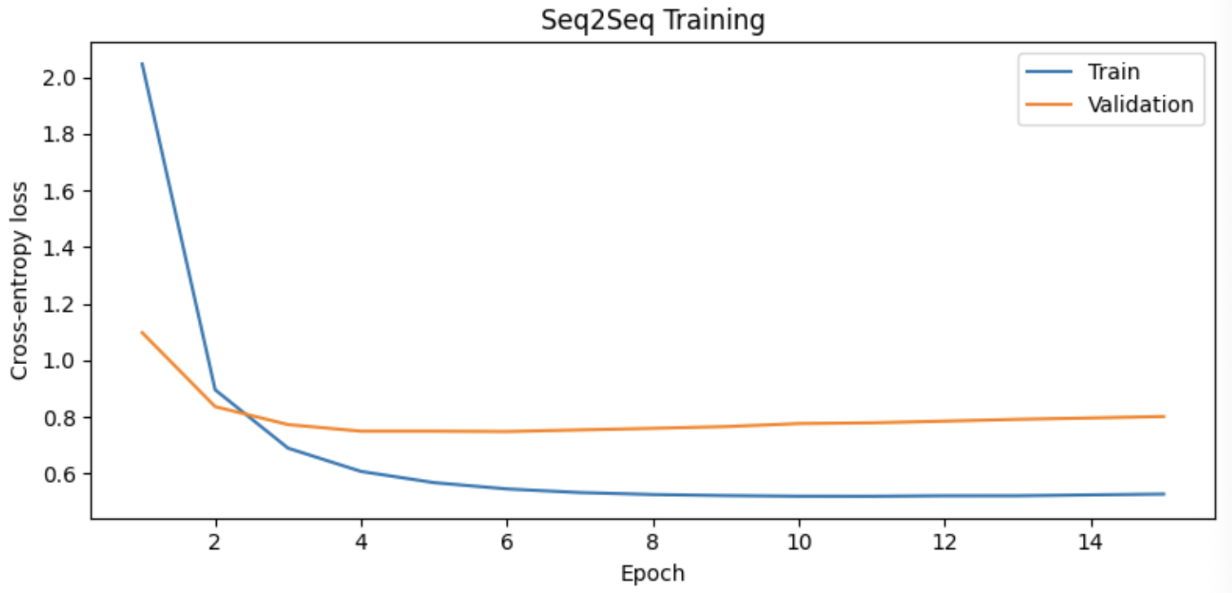

Encoder–Decoder solution (3)

Slide 27
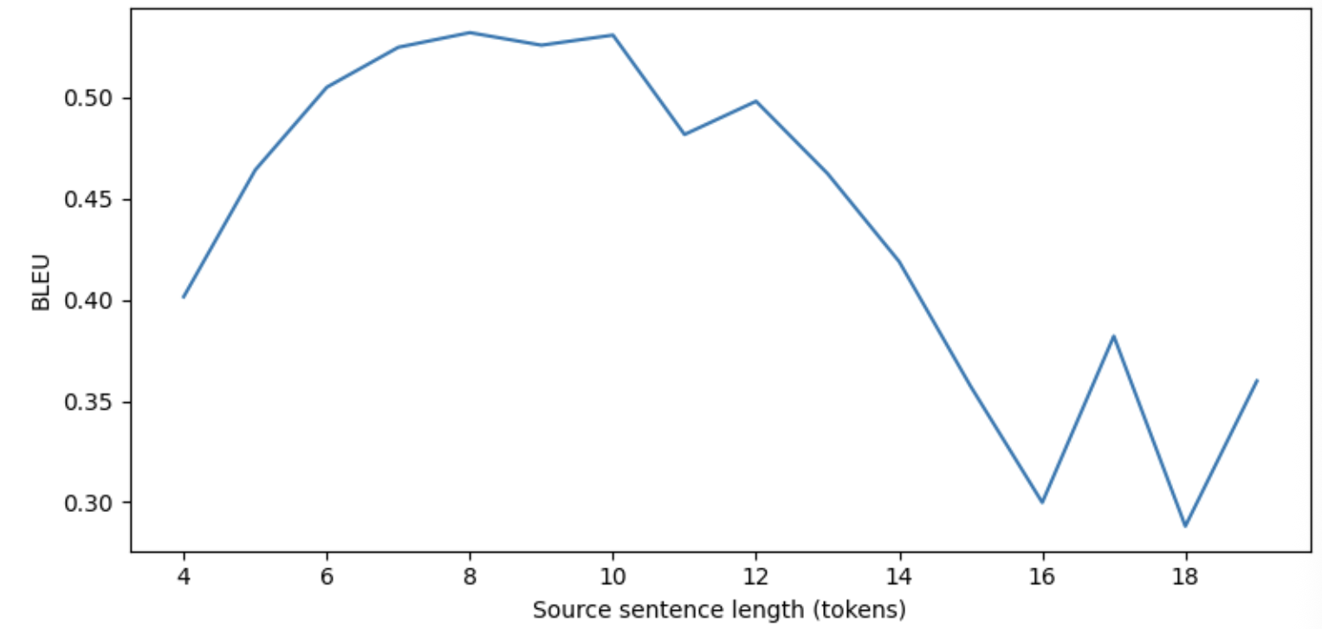
Encoder–Decoder solution (4)

Slide 28
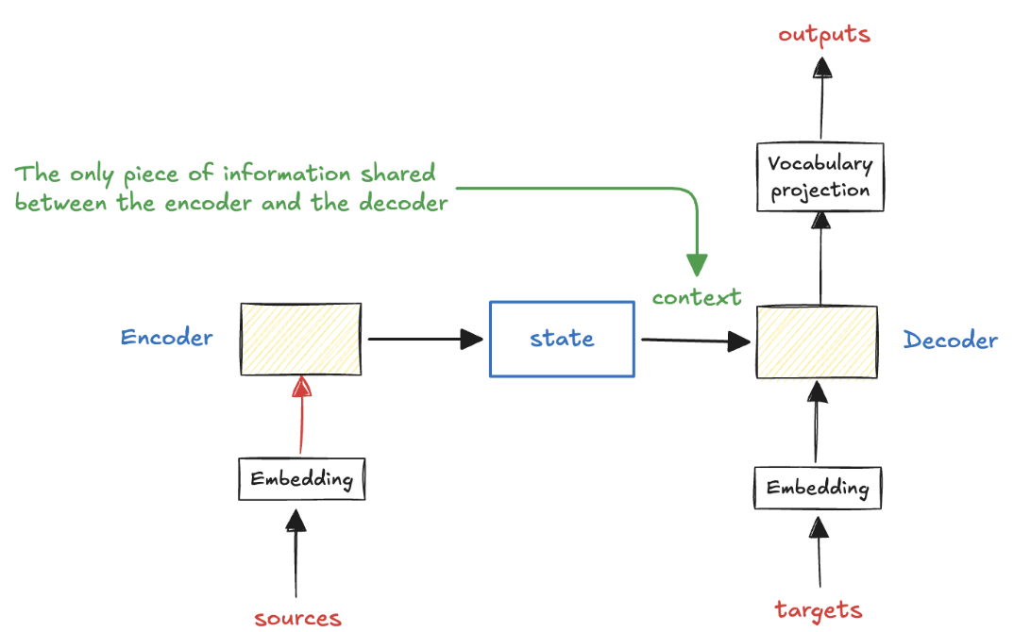
Limitation
The encoder compresses all the information contained in the input sequence into a single fixed-dimensional representation
This representation is then passed to the decoder, which relies on it as the sole source of information for generating the output sequence
While this is reasonable when the input is short and the amount of information to be retained is limited, it becomes problematic as the input grows in length or complexity.

Slide 29
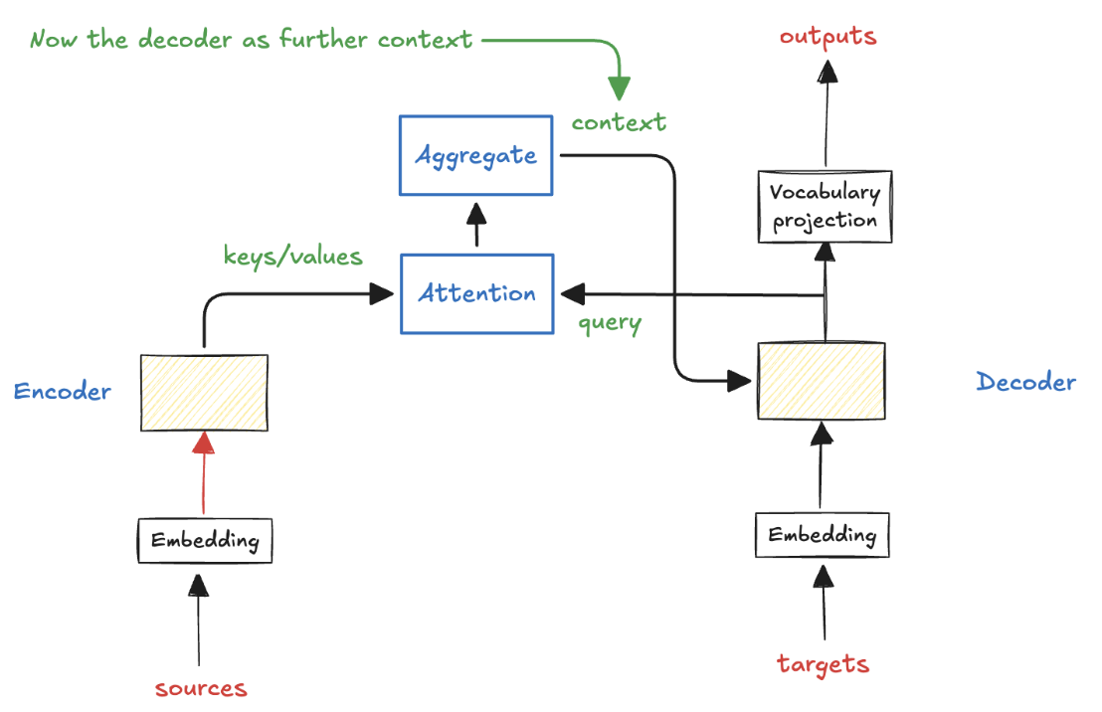
Adding Attention (1)
When humans translate a sentence, they do not rely on a single compressed summary of the entire source. Instead, while generating each word, they selectively focus on the parts most relevant at that particular moment
Rather than forcing the decoder to generate the entire translation from a single fixed-size vector, it is possible to apply attention mechanisms that allow the decoder to access the entire sequence of encoder hidden states.

Slide 30
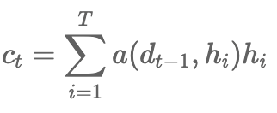


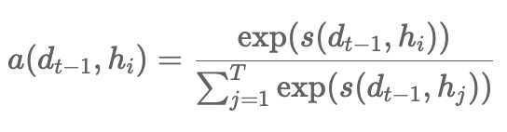
Adding Attention (2)
At each decoding step, the decoder's current hidden state acts as the query, since it encodes what the model is currently looking for. The encoder hidden states serve as both keys, used to compute relevance scores against the query, and values, the actual content to be aggregated.
The resulting attention weights define a soft alignment between source and target
The weights measure how relevant each position of the source (i) is for generating the token at the current positions of the target (t).
The score that produce the weights can be any of the scoring functions we have discussed,:

Slide 31
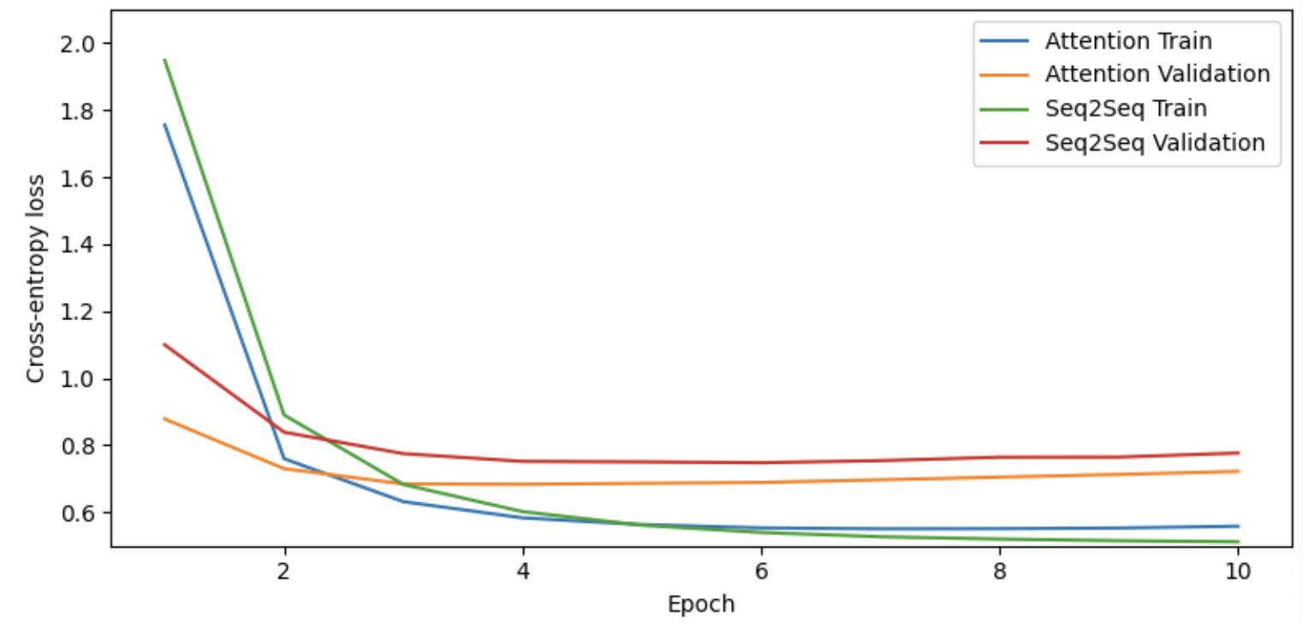

Attention Seq2Seq (1)

Slide 32
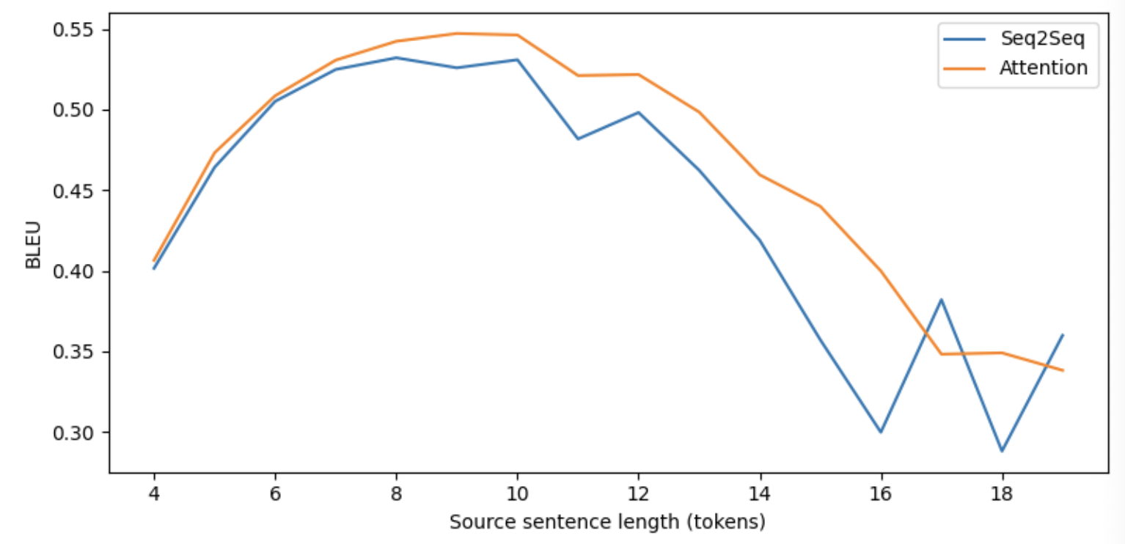
Attention Seq2Seq (2)

Slide 33
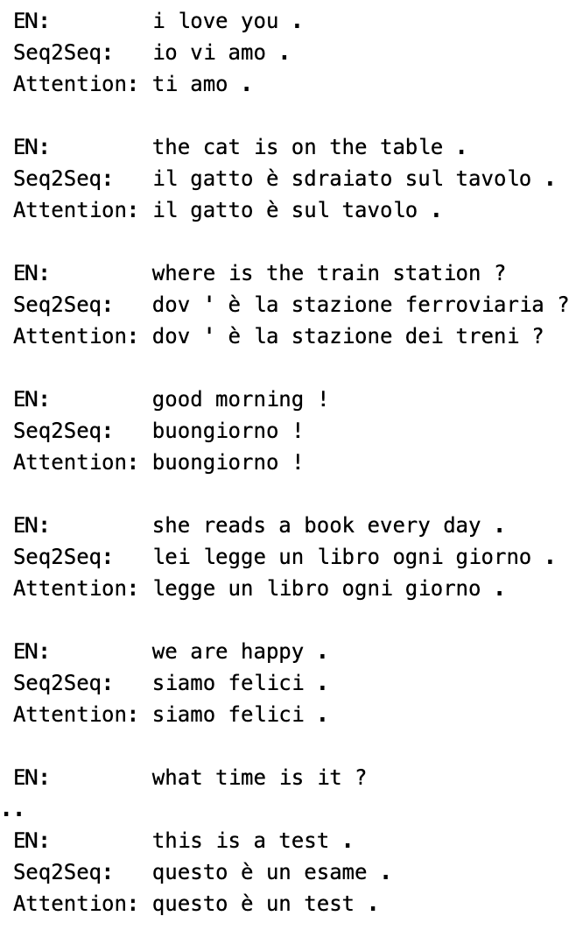
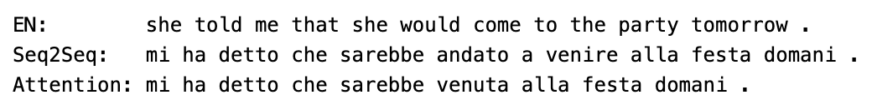
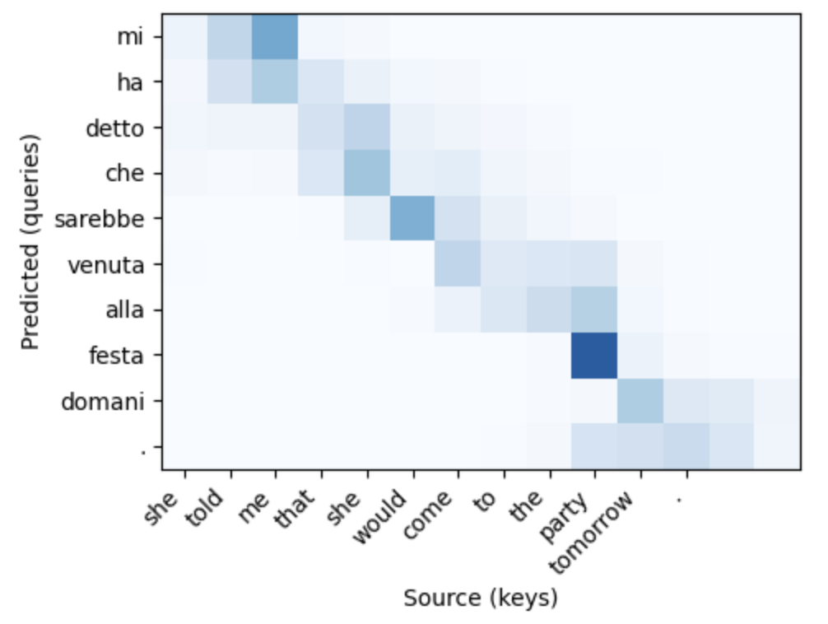
Showing Attention

Slide 34
Attention is all you need
The encoder–decoder it still carries a fundamental limitation inherited from the recurrent architecture: tokens are processed sequentially.
At each time step, the GRU must wait for the previous hidden state before it can compute the next one, which means the computation cannot be parallelized across the sequence dimension.
training is slow on long sequences
gradients must travel through many recurrent steps to reach early tokens
The natural question is: if the decoder already uses attention to dynamically query the encoder at every step, do we actually need the recurrence at all?
NO: Vaswani et al. (2017) in Attention Is All You Need paper
The GRU role in the encoder is to build a representation of each token that is informed by its context, the tokens that surround it.
But this is precisely what attention already does: it aggregates information from a set of positions weighted by relevance.
If we apply attention not between two different sequences but within the same sequence we can build thw context-aware representations without any recurrence at all.

Slide 35
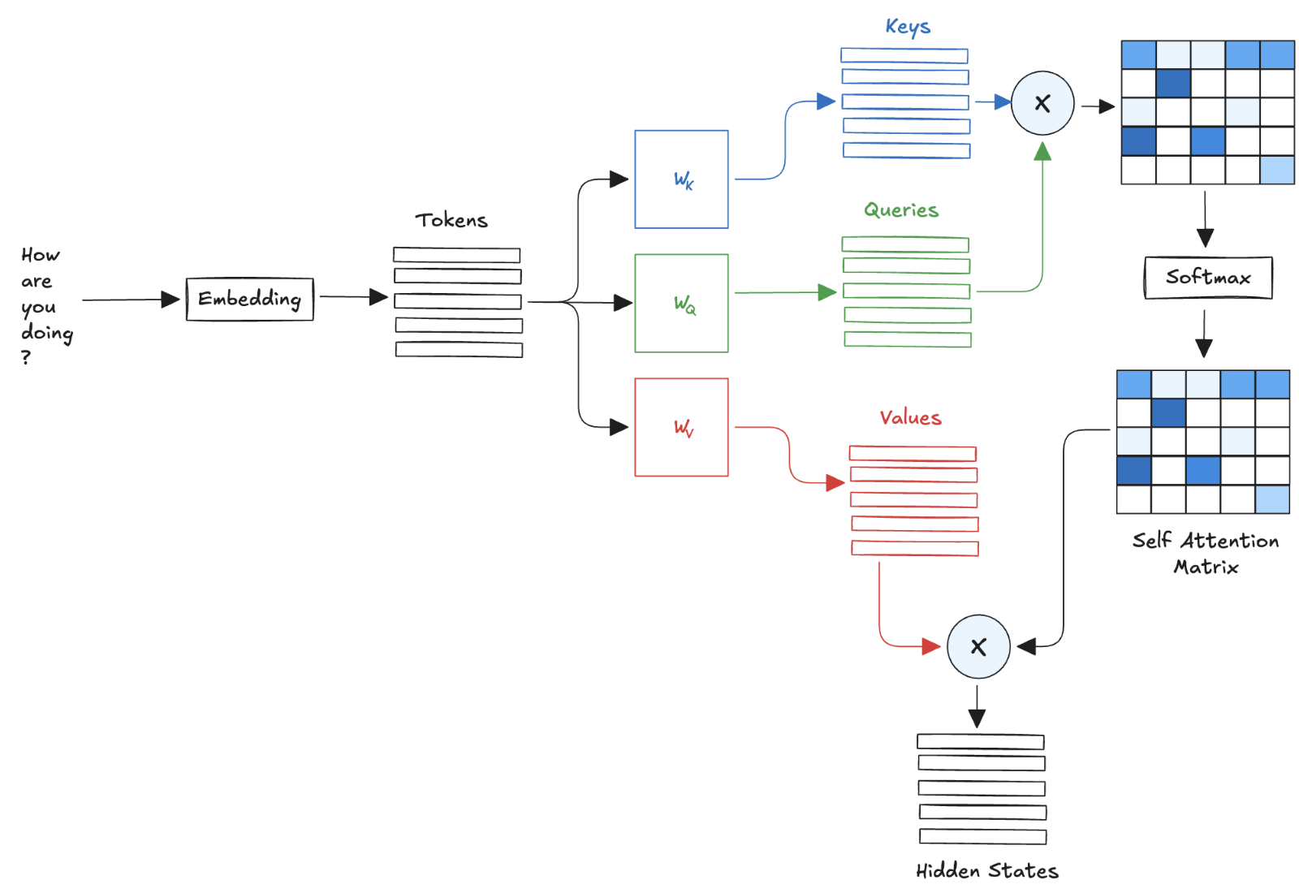
Self Attention

Slide 36
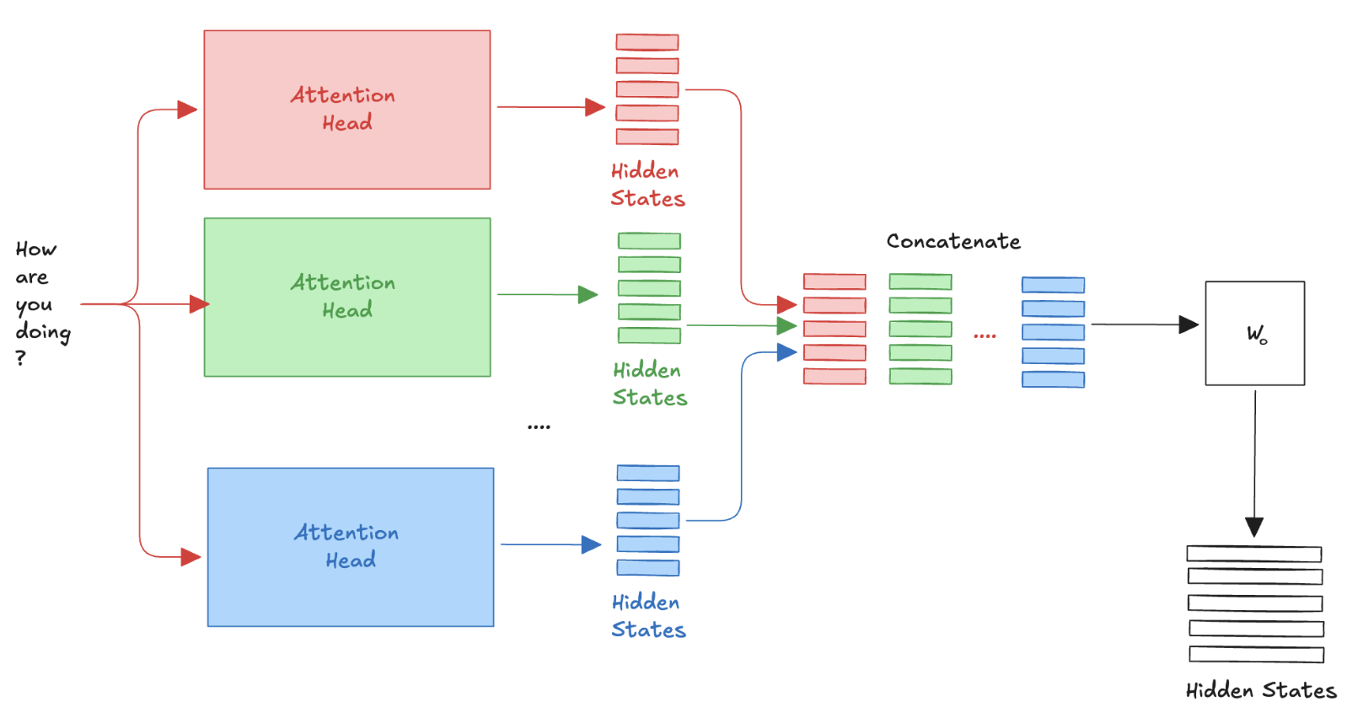
Multi-head Attention
A single self-attention computes one weighted combination of values
The model is limited to capture one type of relationship at a time, for example syntactic agreement or semantic similarity, but not both simultaneously.
Multi-head attention addresses this by running several independent self-attention operations in parallel

Slide 37
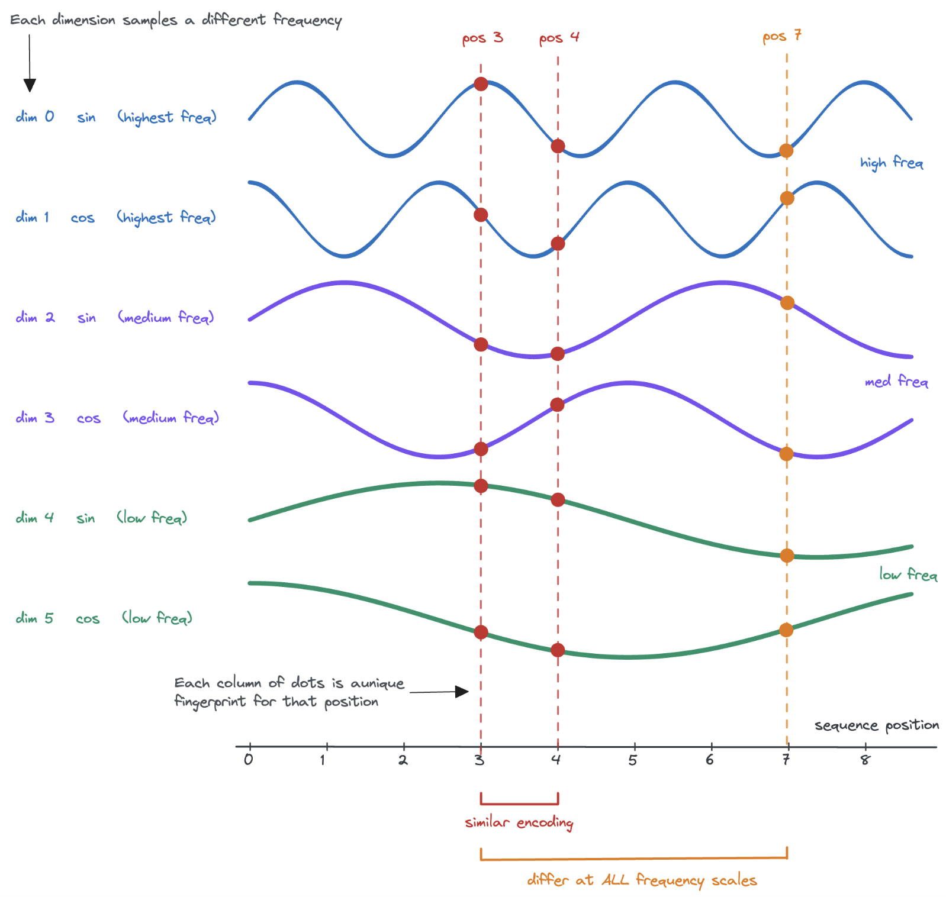
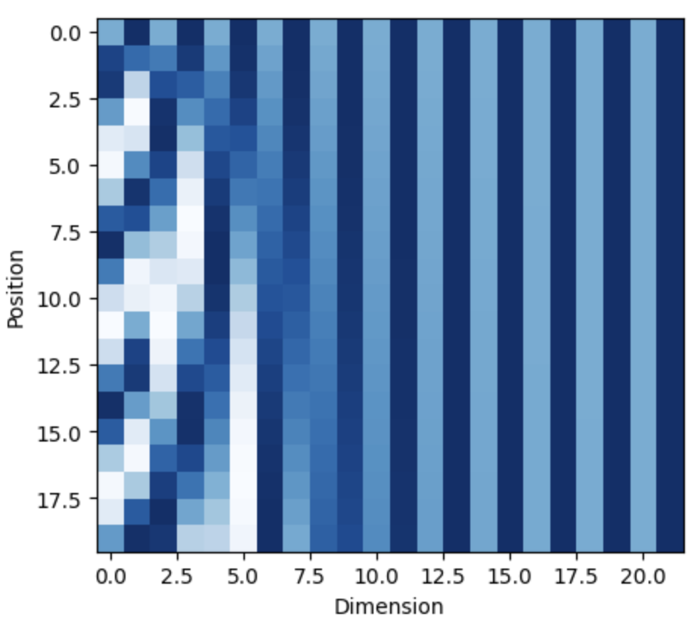
Positional Encodings
Self-attention has no intrinsic notion of order.
We need to inject positional information into the token representations
Embedding: what the token is
Position encodings: where the token occurs
At first glance, it seems natural to use a simple scalar index. However, sequence data contains structure at many scales simultaneously

Slide 38
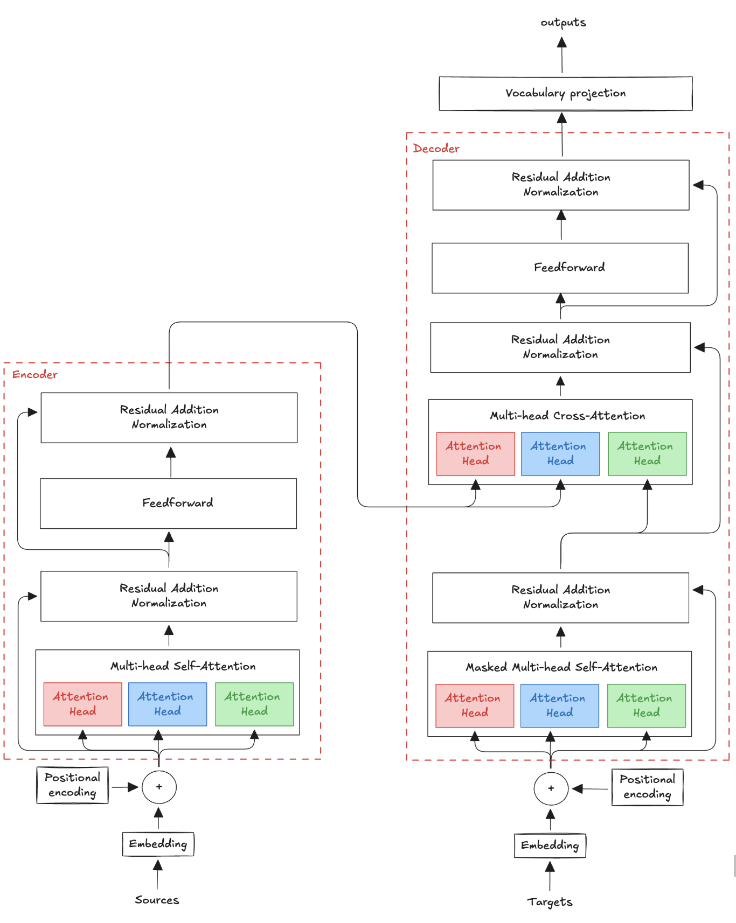
Transformer Architecture (1)

Slide 39
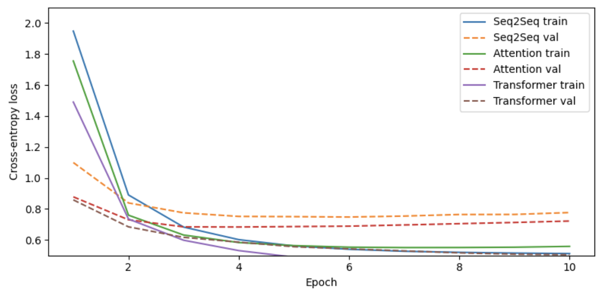
Transformer Architecture (2)

Slide 40
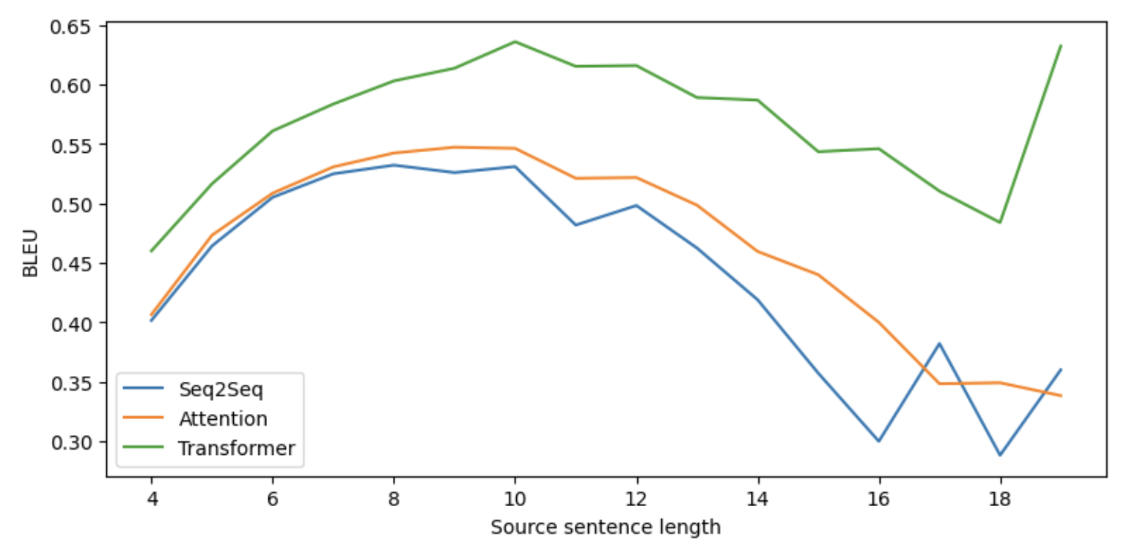
Transformer Architecture (3)

